Slide 1
Divide and Conquer Algorithm

Slide 2
Divide And Conquer
This technique can be divided into the following three parts:
Divide: This involves dividing the problem into smaller sub-problems.
Conquer: Solve sub-problems by calling recursively until solved.
Combine: Combine the sub-problems to get the final solution of the whole problem.

Slide 3


The following are some standard algorithms that follow Divide and Conquer algorithm.
Quicksort is a sorting algorithm. The algorithm picks a pivot element and rearranges the array elements so that all elements smaller than the picked pivot element move to the left side of the pivot, and all greater elements move to the right side. Finally, the algorithm recursively sorts the subarrays on the left and right of the pivot element.
Merge Sort is also a sorting algorithm. The algorithm divides the array into two halves, recursively sorts them, and finally merges the two sorted halves.

Slide 4
Binary Search
Problem: Given a sorted array arr[] of n elements, write a function to search a given element x in arr[].
Input: arr[] = {10, 20, 30, 50, 60, 80, 110, 130, 140, 170}, x = 110 Output: 6 Explanation: Element x is present at index 6
Input: arr[] = {10, 20, 30, 40, 60, 110, 120, 130, 170}, x = 175 Output: -1 Explanation: Element x is not present in arr[].

Slide 5
Binary Search Algorithm: The basic steps to perform Binary Search are:
Begin with an interval covering the whole array.
If the value of the search key is less than the item in the middle of the interval, narrow the interval to the lower half.
Otherwise, narrow it to the upper half.
Repeatedly check until the value is found or the interval is empty.

Slide 6
Search Single Element in a sorted array
Problem Statement: Given a sorted array of N integers, where every element except one appears exactly twice and one element appears only once. Search Single Element in a sorted array.
Example 1:
Input: N = 9, array[] = {1,1,2,3,3,4,4,8,8} Output: 2
Explanation: Every element in this sorted array except 2 appears twice, therefore the answer returned will be 2.
Example 2:
Input: N = 7, array[] = {11,22,22,34,34,57,57} Output: 11
Explanation: Every element in this sorted array except 11 appears twice, therefore the answer returned will be 11.

Slide 7
Find a peak element
Given an array of integers. Find a peak element in it. An array element is a peak if it is NOT smaller than its neighbours. For corner elements, we need to consider only one neighbour.
Input: array[]= {5, 10, 20, 15}
Output: 20
The element 20 has neighbours 10 and 15, both of them are less than 20.
Input: array[] = {10, 20, 15, 2, 23, 90, 67}
Output: 20 or 90
The element 20 has neighbours 10 and 15, both of them are less than 20, similarly 90 has neighbours 23 and 67.

Slide 8
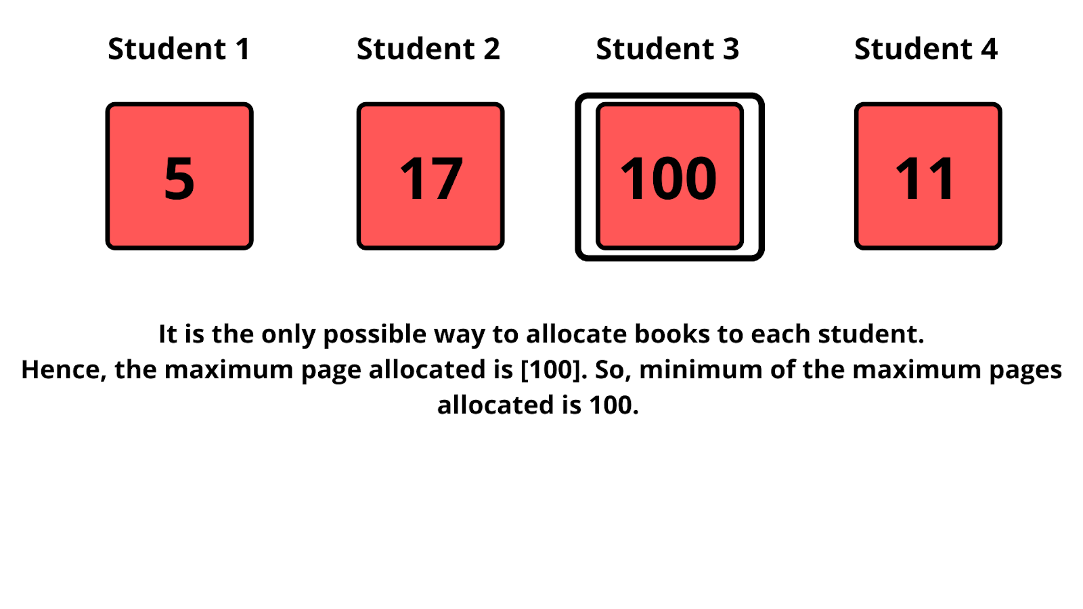
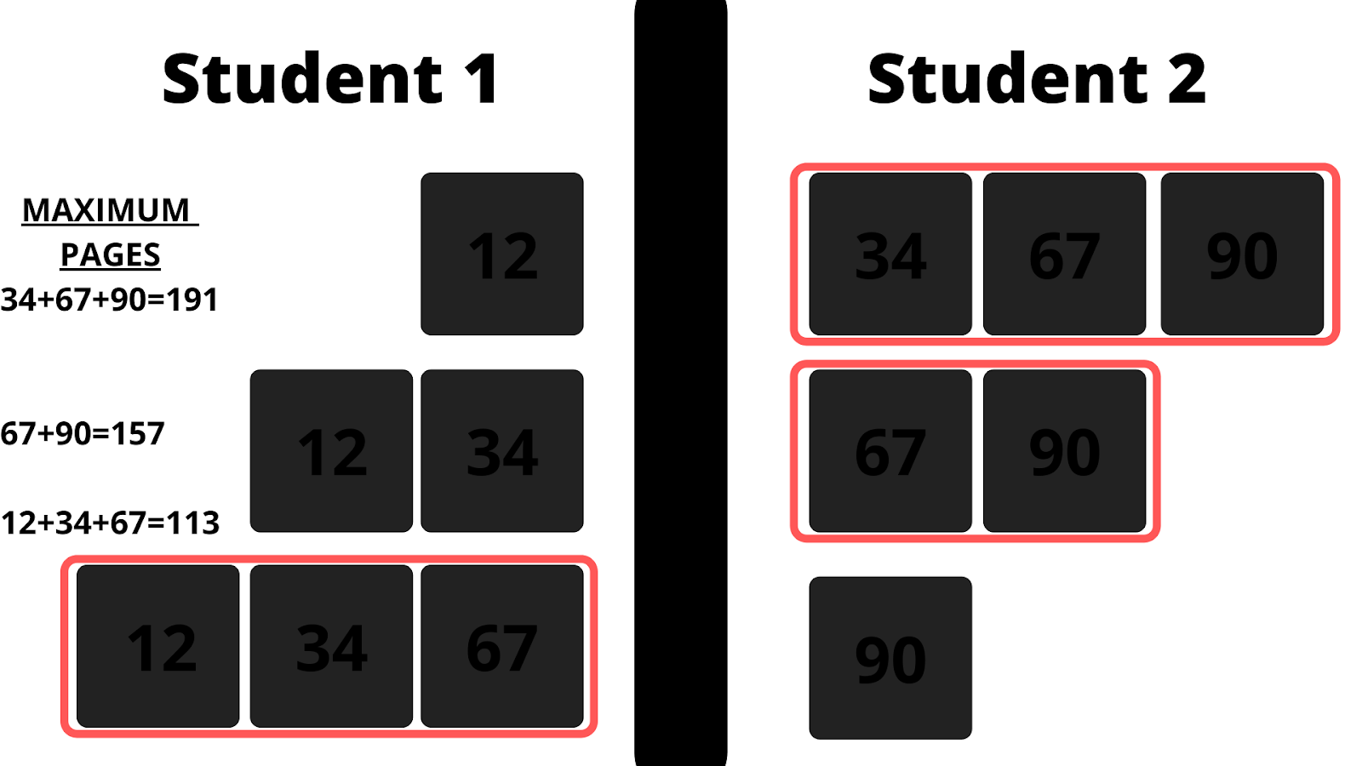
Allocate Minimum Number of Pages
Problem Statement: Given an array of integers A of size N and an integer B.
The College library has N bags, the ith book has A[i] number of pages.
You have to allocate books to B number of students so that the maximum number of pages allocated to a student is minimum.
Conditions given :
A book will be allocated to exactly one student.
Each student has to be allocated at least one book.
Allotment should be in contiguous order, for example, A student cannot be allocated book 1 and book 3, skipping book 2.
Calculate and return the minimum possible number. Return -1 if a valid assignment is not possible.
Examples:
Example 1: Input: A = [12, 34, 67, 90] B = 2 Output: 113
Explaination: Let’s see all possible cases of how books can be allocated for each student.So, the maximum number of pages allocated in each case is [191,157,113]. So, the minimum number among them is 113. Hence, our result is 113.
Example 2: Input: A = [5, 17, 100, 11] B = 4 Output: 100

Slide 9
Search in a sorted 2D matrix
Problem Statement: Given an m*n 2D matrix and an integer, write a program to find if the given integer exists in the matrix.
Given matrix has the following properties:
Integers in each row are sorted from left to right.
The first integer of each row is greater than the last integer of the previous row
Example 1:
Input: matrix = [[1,3,5,7], [10,11,16,20], [23,30,34,60]], target = 3
Output: true
Explanation: As the given integer(target) exists in the given 2D matrix, the function has returned true.
Example 2:
Input: matrix = [[1,3,5,7], [10,11,16,20], [23,30,34,60]], target = 13
Output: false
Explanation: As the given integer(target) does not exist in the given 2D matrix, the function has returned false.

Slide 10
Count inversions in an array
Problem Statement: Given an array of N integers, count the inversion of the array (using merge-sort).
What is an inversion of an array?
Definition: for all i & j < size of array, if i < j then you have to find pair (A[i],A[j]) such that A[j] < A[i].
Example 1:
Input Format: N = 5, array[] = {1,2,3,4,5} Result: 0
Explanation: we have a sorted array and the sorted array has 0 inversions as for i < j you will never find a pair such that A[j] < A[i]. More clear example: 2 has index 1 and 5 has index 4 now 1 < 5 but 2 < 5 so this is not an inversion.
Example 2:
Input Format: N = 5, array[] = {5,4,3,2,1} Result: 10
Explanation: we have a reverse sorted array and we will get the maximum inversions as for i < j we will always find a pair such that A[j] < A[i]. Example: 5 has index 0 and 3 has index 2 now (5,3) pair is inversion as 0 < 2 and 5 > 3 which will satisfy out conditions and for reverse sorted array we will get maximum inversions and that is (n)*(n-1) / 2. For above given array there is 4 + 3 + 2 + 1 = 10 inversions.
Example 3:
Input Format: N = 5, array[] = {5,3,2,1,4} Result: 8
Explanation: There are 7 pairs (5,1), (5,3), (5,2), (5,4), (3,2), (3,1), (2,1) and we have left 2 pairs (2,4) and (1,4) as both are not satisfy our condition.

Slide 11



















Merge Sort
Like QuickSort, Merge Sort is a Divide and Conquer algorithm. It divides the input array into two halves, calls itself for the two halves, and then merges the two sorted halves. The merge() function is used for merging two halves. The merge(arr, l, m, r) is a key process that assumes that arr[l..m] and arr[m+1..r] are sorted and merges the two sorted sub-arrays into one.
MergeSort(arr[], l, r)
If r > l
1. Find the middle point to divide the array into two halves: middle m = l+ (r-l)/2 2. Call mergeSort for first half: Call mergeSort(arr, l, m)
3. Call mergeSort for second half: Call mergeSort(arr, m+1, r)
4. Merge the two halves sorted in step 2 and 3: Call merge(arr, l, m, r)

Slide 12
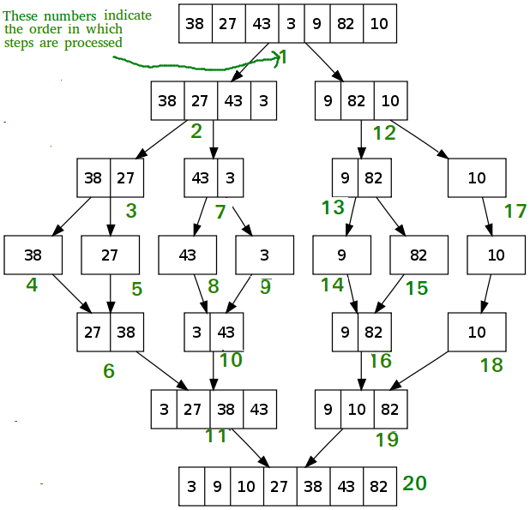










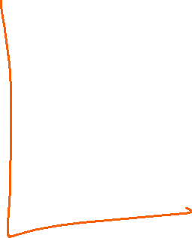




Slide 13


Slide 14




























Slide 15

































QuickSort
Like Merge Sort, QuickSort is a Divide and Conquer algorithm. It picks an element as pivot and partitions the given array around the picked pivot. There are many different versions of quickSort that pick pivot in different ways.
Always pick first element as pivot.
Always pick last element as pivot (implemented below)
Pick a random element as pivot.
Pick median as pivot.
The key process in quickSort is partition(). Target of partitions is, given an array and an element x of array as pivot, put x at its correct position in sorted array and put all smaller elements (smaller than x) before x, and put all greater elements (greater than x) after x. All this should be done in linear time.

Slide 16








/* low --> Starting index, high --> Ending index */
quickSort(arr[], low, high) {
if (low < high) {
/* pi is partitioning index, arr[pi] is now at right place */
pi = partition(arr, low, high);
quickSort(arr, low, pi - 1); // Before pi
quickSort(arr, pi + 1, high); // After pi
}
}

Slide 17
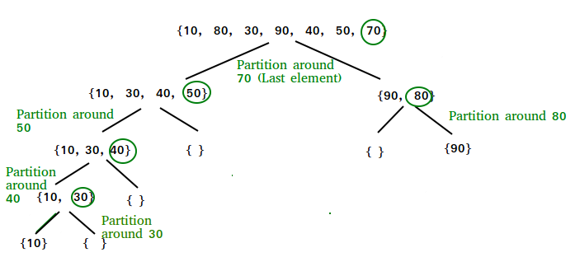













Slide 18


























Slide 19







Slide 20





















Slide 21








Slide 22
Nth Root of a Number using Binary Search
Problem Statement: Given two numbers N and M, find the Nth root of M.
The nth root of a number M is defined as a number X when raised to the power N equals M.
Input: N=3 M=27 Output: 3
Explanation: The cube root of 27 is 3.
Example 2:
Input: N=2 M=16 Output: 4
Explanation: The square root of 16 is 4
Example 3:
Input: N=5 M=243 Output: 3 Explaination: The 5th root of 243 is 3

